Slide 1
One Time Pad

Slide 2
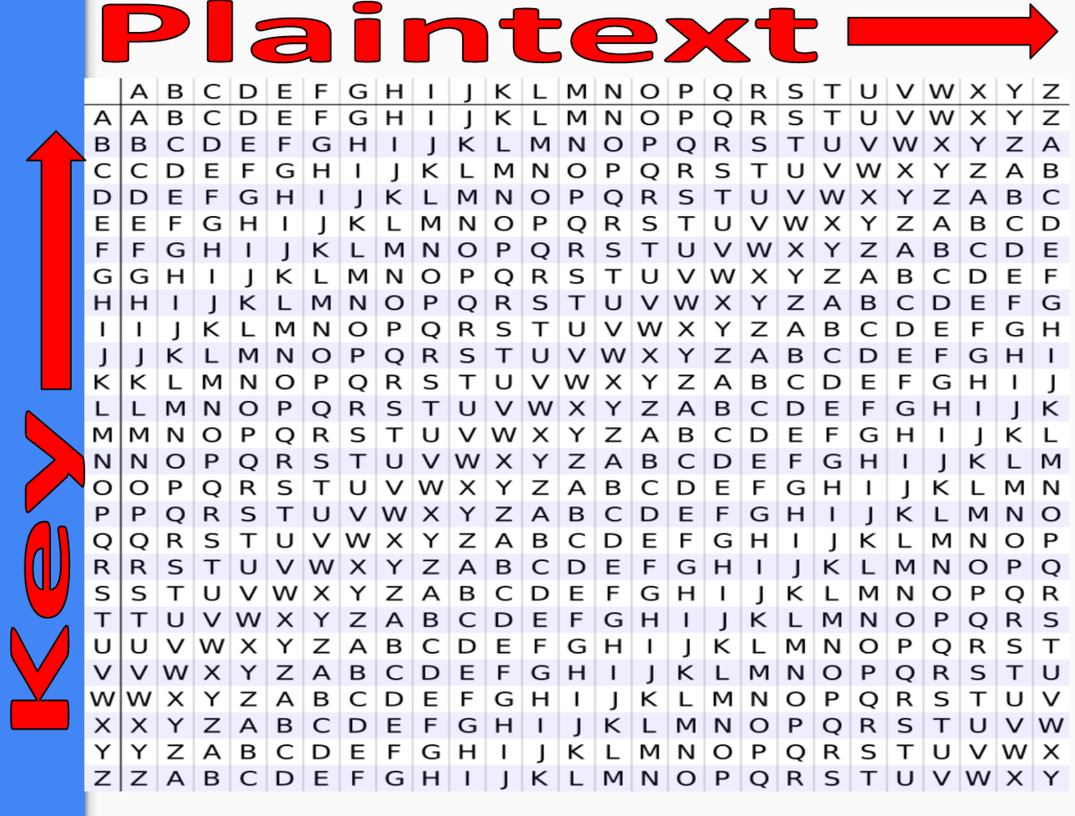
Review of Vigenere
Similar to Caesar Cipher, but much more secure since rather than encrypting an entire word or message by one shift, each individual character in encrypted by a different shift, in other words, a password, that you choose.

Slide 3
Let’s Encrypt a Message by Hand Together
Plaintext we want to Encrypt:
Amazon
Using the key:
Bezos

Slide 4
Decrypting when Knowing the Key
Cipher-Text w/ key of Bezos:
BQZNGO

Slide 5
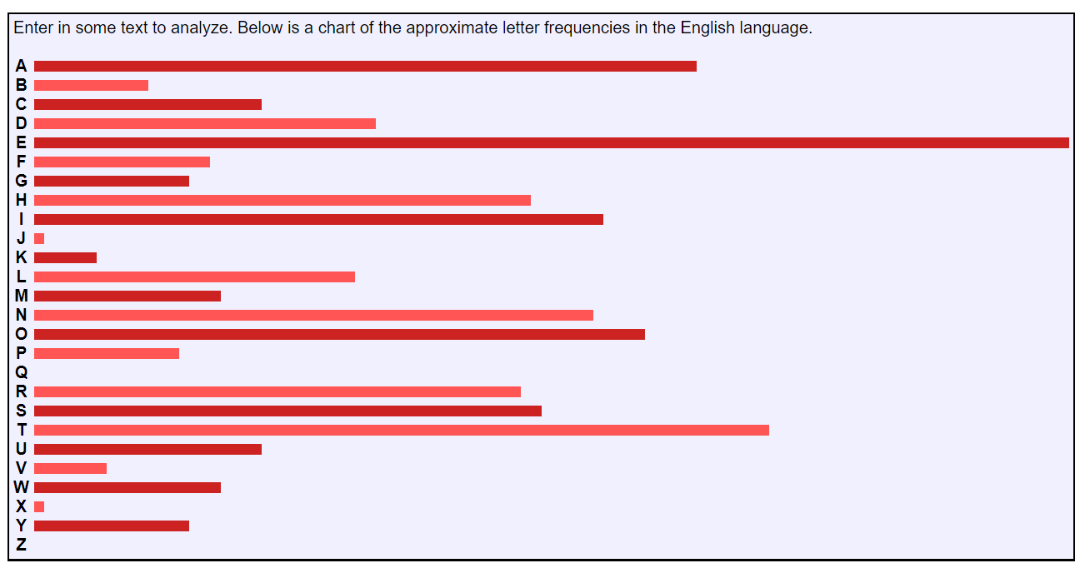
What Happens when you don’t know the key?
A lot of math! Cryptologists first steps would be check what’s called the frequency analysis of the cipher text in question. Assuming the key is a legitimate word, it will be somewhat similar to this graph.
https://www.youtube.com/watch?v=QgHnr8-h0xI

Slide 6
What is One Time Pad?
Method of encryption
Symmetrical Encryption
1 key only
Same key for encryption and decryption

Slide 7
How does One Time Pad work?
Key properties:
As long as the message
RANDOM!
Pre-shared securely
Cannot reuse
Each letter (or bit) of the message is encrypted using each corresponding letter (or bit) of the key
AKA the PERFECT cipher
Notes:
Problem:
Secure key exchange

Slide 8

One Time Pad Video!

Slide 9
Example (Encrypting)
Message = HELLO (= 7, 4, 11, 11, 14)
Key = XMCKL (= 23, 12, 2, 10, 11)
Add them up → (= 30, 16, 13, 21, 25)
Modulo 26 → (= 4, 16, 13, 21, 25)
Convert that into letter and we have encrypted a message with the perfect Cipher:
Encrypted message = EQNVZ
Note: We used modular addition as a technique to encrypt, but anything else can be used as well - usually done in XOR
A B C D E F G H I J K L M N O P Q R S T U V W X Y Z
0 1 2 3 4 5 6 7 8 9 10 11 12 13 14 15 16 17 18 19 20 21 22 23 24 25

Slide 10
Example (Decrypting)
Encrypted Message: EQNVZ (= 4, 16, 13, 21, 25)
Knowing the key: XMCKL (= 23, 12, 2, 10, 11)
Subtract them → (= -19, 4, 11, 11, 14)
-19 = H , 4 = E , 11 = L , 11 = L , 14 = O ----> With -19, the Alphabet continues! (-1=Z, 26=A, …)
A B C D E F G H I J K L M N O P Q R S T U V W X Y Z
0 1 2 3 4 5 6 7 8 9 10 11 12 13 14 15 16 17 18 19 20 21 22 23 24 25

Slide 11
Your Turn!
Using the keyword “sleepingbeauty” encode
meetmeatatnoon
whohasthemoney
Using the keyword “sleepingbeauty” decode
dfrgwqfgusny
Btqlpagnfqohxw
For your convenience:
A B C D E F G H I J K L M N O P Q R S T U V W X Y Z
0 1 2 3 4 5 6 7 8 9 10 11 12 13 14 15 16 17 18 19 20 21 22 23 24 25
Notes:
1a-
Meet me at noon = 12 4 4 19 12 4 0 19 13 14 14 13
Cipher = epixbmnzosoh = 4 15 8 23 1 12 13 25 14 18 14 7
1b-
Who has the money = 22 7 14 7 0 18 19 7 4 12 14 13 4 24
Cipher = osslpagnfqohxw = 14 18 18 11 15 0 6 13 5 16 14 7 23 22
2a-
Dfrgwqfgusny = 3 5 17 6 22 16 5 6 20 18 13 24
Message = lunchisatone = 11 20 13 2 7 8 18 0 19 14 13 4
2b-
Btqlpagnfqohxw = 1 19 16 11 15 0 6 13 5 16 14 7 23 22
Message = jimhasthemoney = 9 8 12 7 0 18 19 7 4 12 14 13 4 24

Slide 12
RSA

Slide 13

What is RSA?
A series of steps to encrypt and decrypt a message!
Named after
R - Rivest, Ron
S - Shamir, Adi
A - Adleman, Leonard

Slide 14
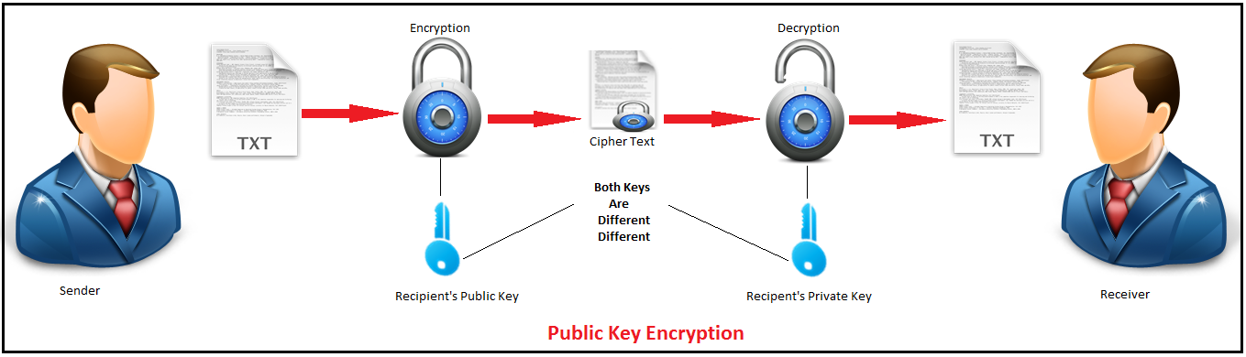
What is RSA?
Asymmetric: 2 keys (vs symmetric - 1 key only)
Public Key Cryptography
2 keys
1 public - known to everyone
1 private - known only to the owner

Slide 15
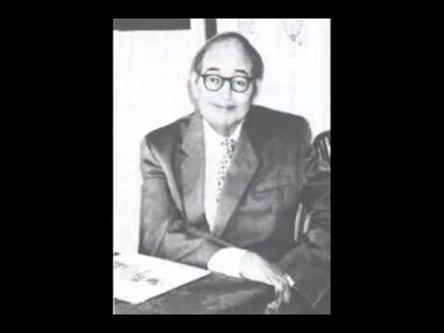
RSA Video!

Slide 16
How does RSA work?
To encrypt an RSA user does the following:
Picks 2 primes
Creates a public and private key
Encrypts the message using their public key
To decrypt:
Receiver uses their own private key to decrypt
Original message can be recovered because of magical math! (But it is complicated enough for us to skip the exact details)

Slide 17

Why does RSA work?
Prime numbers must be kept secret
Because of the math, if the product is large enough - even with very fast computers it takes VERY long to figure out the begining 2 prime numbers
Only someone who knows those prime numbers can decode the message
Super Computer!

Slide 18
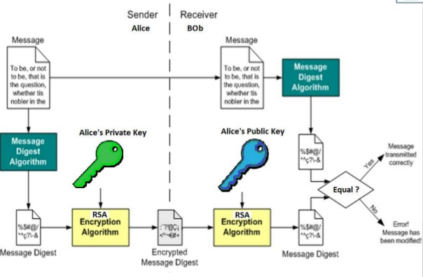
What is RSA used for?
Secure data transmission from one place to another
RSA digital signatures to validate authenticity of people or websites
Verifying computer applications can be digitally signed to ensure integrity since manufacturing

Slide 19


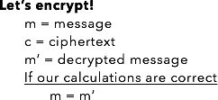

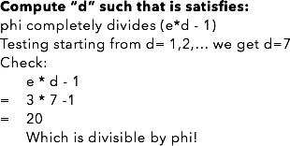
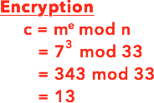




RSA Example
Notes:
http://www.di-mgt.com.au/rsa_alg.html#simpleexample

Slide 20
Let’s Try Together!
Everyone choose your own p and q, generate your public/private key and check whether your encryption works
M = m’

Slide 21
Practice
Callie wants to send the message M = 13 to Alice. Using Alice’s public and private keys, calculate the ciphertext C, and the value for M’ when Alice recovers the message public key: (33,3) private key: (33,7)
Dexter wants to set up his own public and private keys. He chooses p = 23 and q = 19 with e=283. Find d
Notes:
C = 19 M’ = 13
D = 7

Slide 22
Happy Ciphering!

